Slide 1

BC Follow Me

Slide 2
Itinerary for 12/3/2014
Greetings--------------------------------------------------Parker
Recap and Summary---------------------------Parker/Emily
Web Demo-------------------------------------------------Kristen
Questions---------------------------------------------------Kristen
Application Demo--------------------------------------Shannon
Questions -----------------------------------------Kyle/Shannon

Slide 3
Functional Requirements of theApp
The functional requirements we promise to our clients are listed below.
The application allows users to create accounts
The application can display a map with a user’s position.
The user can create or load publically available excursions.
The application can record and display the route the user is traversing.
The user may add observations at various locations on the route and others may view these observations.
The user may set excursion to private or public

Slide 4
Non-Functional Requirements of the App
The non-functional requirements we promise to our clients are listed below.
The system is restricted to registered users. Registration occurs in the application.
The application stores and retrieves data from the local and application server databases as needed.
The user may download excursions prior to losing cell signal and use the excursion (in a limited capacity) without cell service.
Data collected by the application about the excursion, if made public, is saved in the cloud database for other users to download and use.
The user may create and modify excursions (in a limited capacity) without cell signal and once cell signal is gained again the changes made will be uploaded to the cloud database.

Slide 5
Functional and Non-Functional Requirements of the Website
The functional and non-functional requirements of the web page that we promise to our clients are listed below.
The website allows the user to download the Android application.
The website provides an instructional manual about the application.
The website will look professional and will have a similar look and feel to the application.

Slide 6
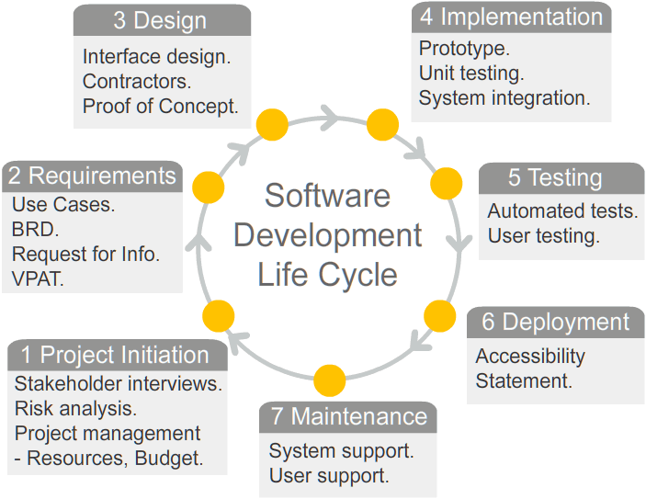
Where We are
We are currently in the testing phase, we will need two more weeks to thoroughly test it, other than that the app is complete

Slide 7
Where the Application is going
We are currently working with the College to determine if they will host it and if we can make the code open source
2 options:
College will host it on Azure website and a department will have to make payments to Azure so we can utilize their cloud database
Or we will host it on an out side server such as Go Daddy

Slide 8
Demo of the Website and Application

